Slide 1
What Is Science (Part 1)
Qualitative Observation

Slide 2

Observation
Science begins with ________ observation.
Looking with a _______ and prior knowledge
Looking to see what is __________ there (not what you think should be there)
There are _____ types of observation in science.
Qualitative Observation (think ___________)
Observing with your ___________ (e.g. sight, feel, etc.)
Quantitative Observation (think ___________)
_____________ with devices (e.g. ruler, scale, etc.)

Slide 3
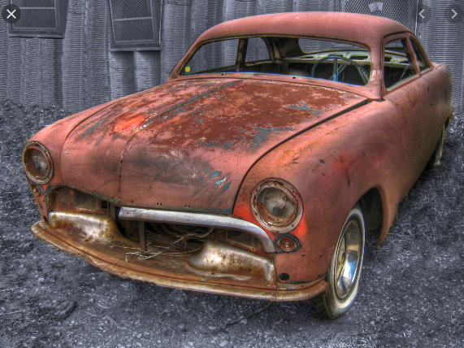
Qualitative Observation
Observing with your senses
_________________
_________________
_________________
_________________
_________________
Observing how something ________
The metal is ________, _________, and __________
Observing how something ___________
When metal rusts it becomes ____, ________, and ________

Slide 4
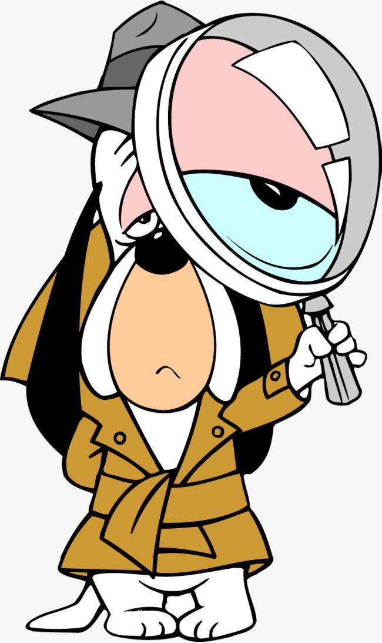
Observation Using Sight
What are some things we can ____ using our eyes?
_________________
_________________
_________________
_________________
_________________

Slide 5

Observation Using Touch & Sound
What are some things we can ______ using our hands?
_________________
_________________
_________________
Sound can sometimes help __________ our touch observations.
Hard things sound _________ than soft things
Caution!
Never _________ things from a sealed ___________ or wrapper unless your teacher says it’s ok.

Slide 6
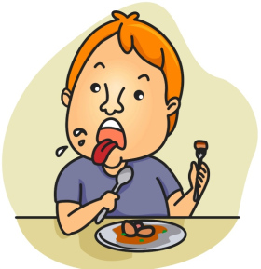
Observation Using Smell & Taste
Double Caution!!
Never, _______ taste __________ in a science classroom
Smell requires a _______ procedure called “_________”
_______ smell anything unless your teacher says it’s ok
Common taste observations:
_________________
Common smell observations:
_________________

